Slide 1
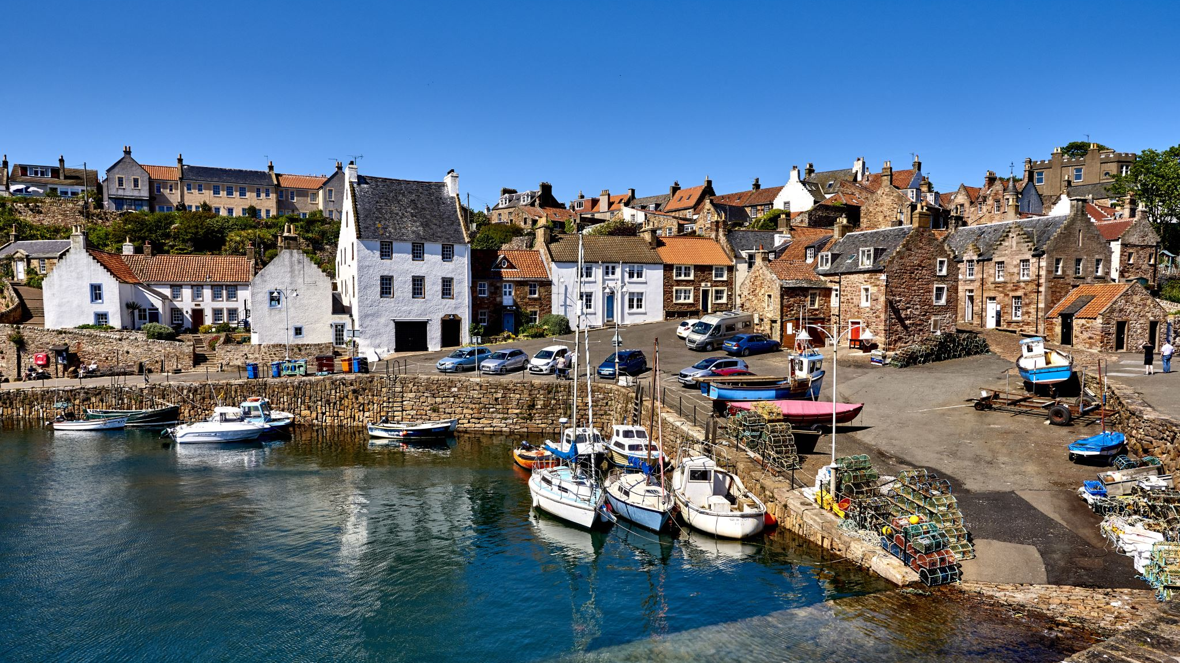
IRELAND CULTURE AND MEDIA
CM 385

Slide 2
COURSE CREDIT
CM 300-400 level class
Free Elective
Non- Department Elective

Slide 3
Course
Prep: Study of Ireland culture (prep with articles, choice of movies)
Cultural Immersion:
Study of media text
Production of Media Text
Showcase basic skills Using i-phone for video, audio and graphics
Final Project due on Adobe Text Design (blog posting site) by end of the Maymester

Slide 4
TOUR DUBLIN AND GALWAY
9 DAY TOUR
MAY 23-JUNE 1
$3950 PLUS airfare
INCLUDES:
Course credit, accommodations, all breakfasts, some snacks, at minimum two dinners
Transportation in Ireland/guided tours

Slide 5
Plane Tickets

Slide 6
*Flexible: Can meet up with US, or go on your own
Not included
Can plan on your own, or can plan with the the World Strides touring company

Slide 7
Accommodations
*Bunking Up
3 Star Accommodations/Dublin
University of Galway Dorms, in Galway

Slide 8
DUBLIN PLANS

Slide 9
Tour INCLUDES
Trinity College and Book of Kells, Irish Emigration Museum, , Viking Culture Museum

Slide 10
Dublin
Tour of Guinness Brewery, Jameson Distillery

Slide 11
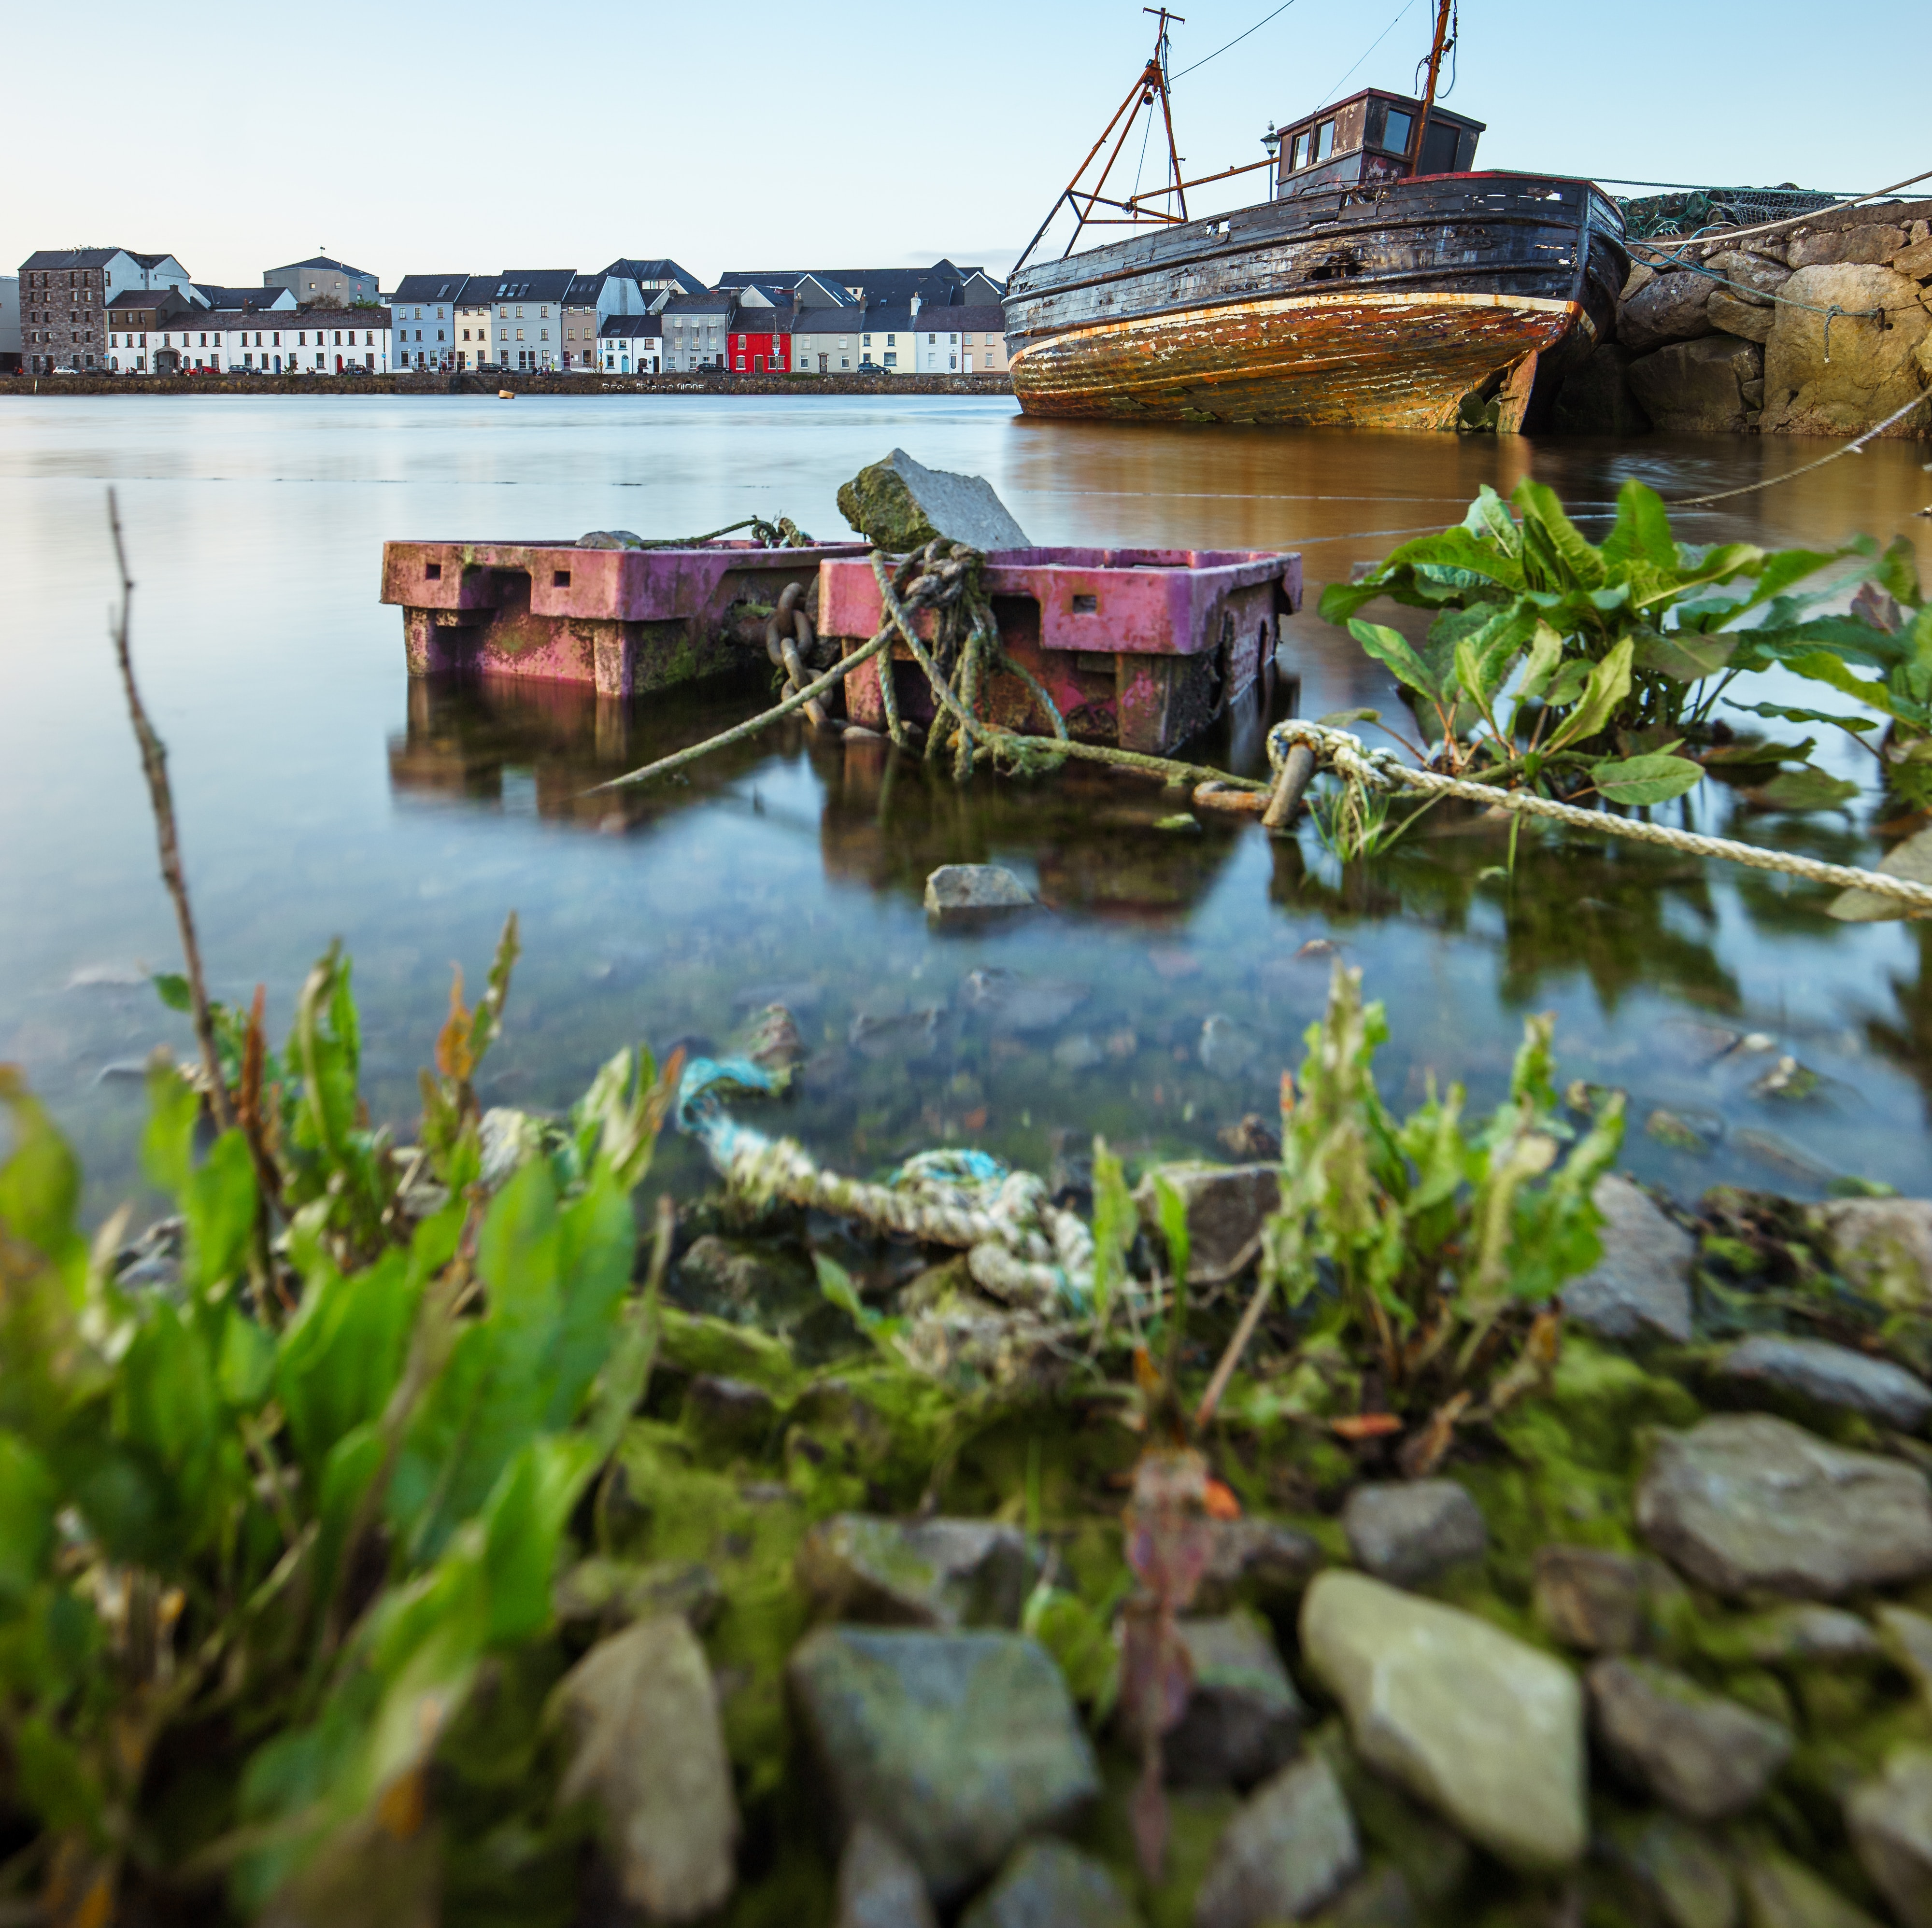
Galway Highlights
Cliffs of Moher
Kylmore Abbey
Galway Cathedral
Aran Island Day Trip

Slide 12
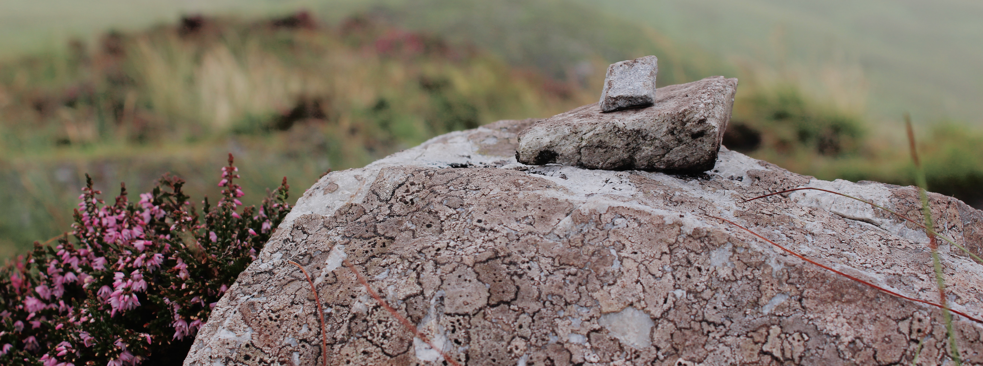
TOUR OF CONNEMARA NATIONAL PARK

Slide 13
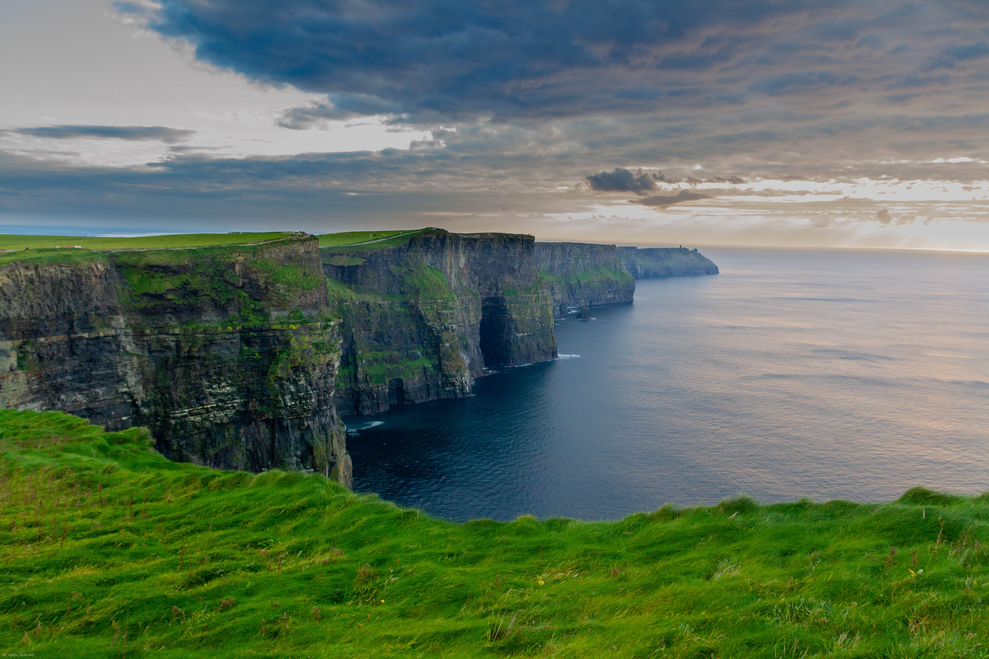
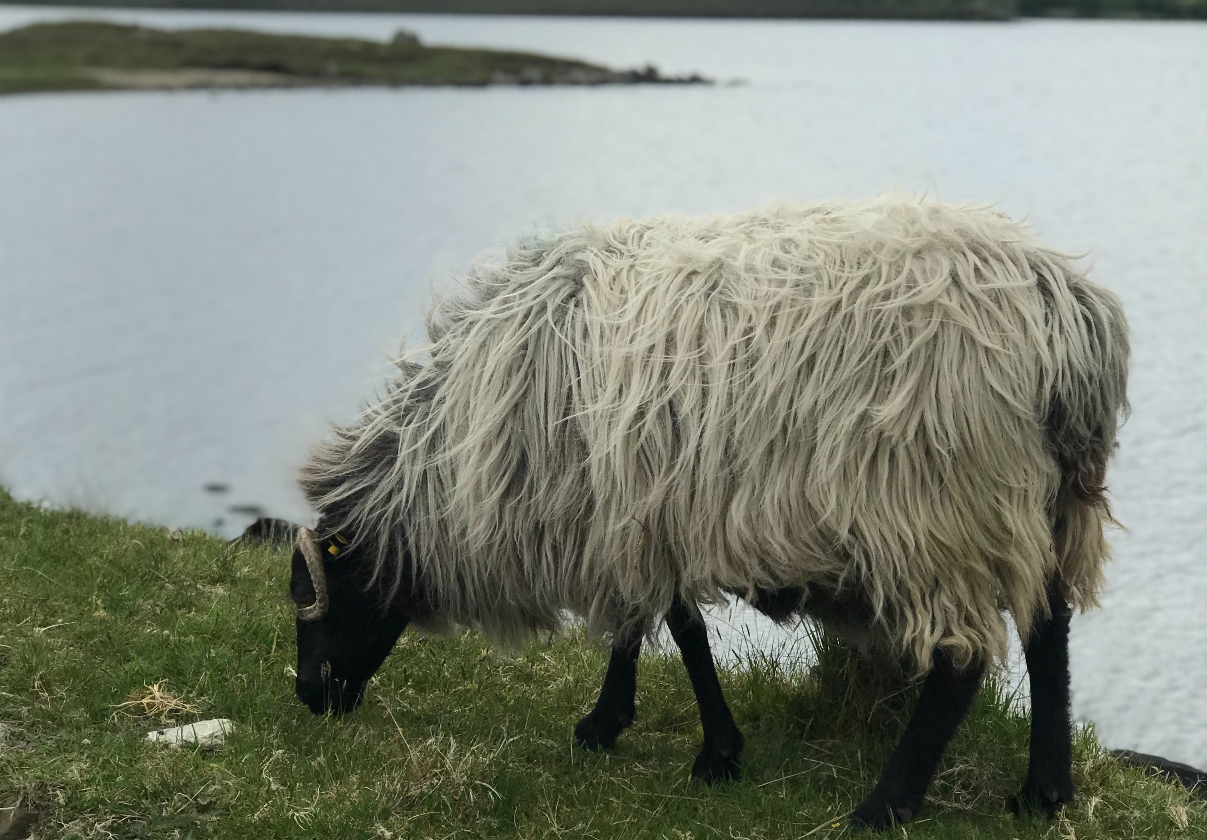
QUESTIONS?

